Slide 1
Data Visualization in R
Yvonne Yang

Slide 2
Tables of contents
Introduction to visualization
Static Visualization (ggplot)
Interactive Visualization (plotly & ggplotly)
Shiny

Slide 3
01
Introduction to Visualization

Slide 4
Why Visualization Matters?
It helps us see patterns quickly
e.g. Which model performs best for each metrics?
Model | AUC | Accuracy | Precision | Recall
Model A | 0.82 | 0.78 | 0.75 | 0.81
Model B | 0.87 | 0.76 | 0.80 | 0.79
Model C | 0.84 | 0.83 | 0.77 | 0.85
Model D | 0.80 | 0.79 | 0.82 | 0.76

Slide 5
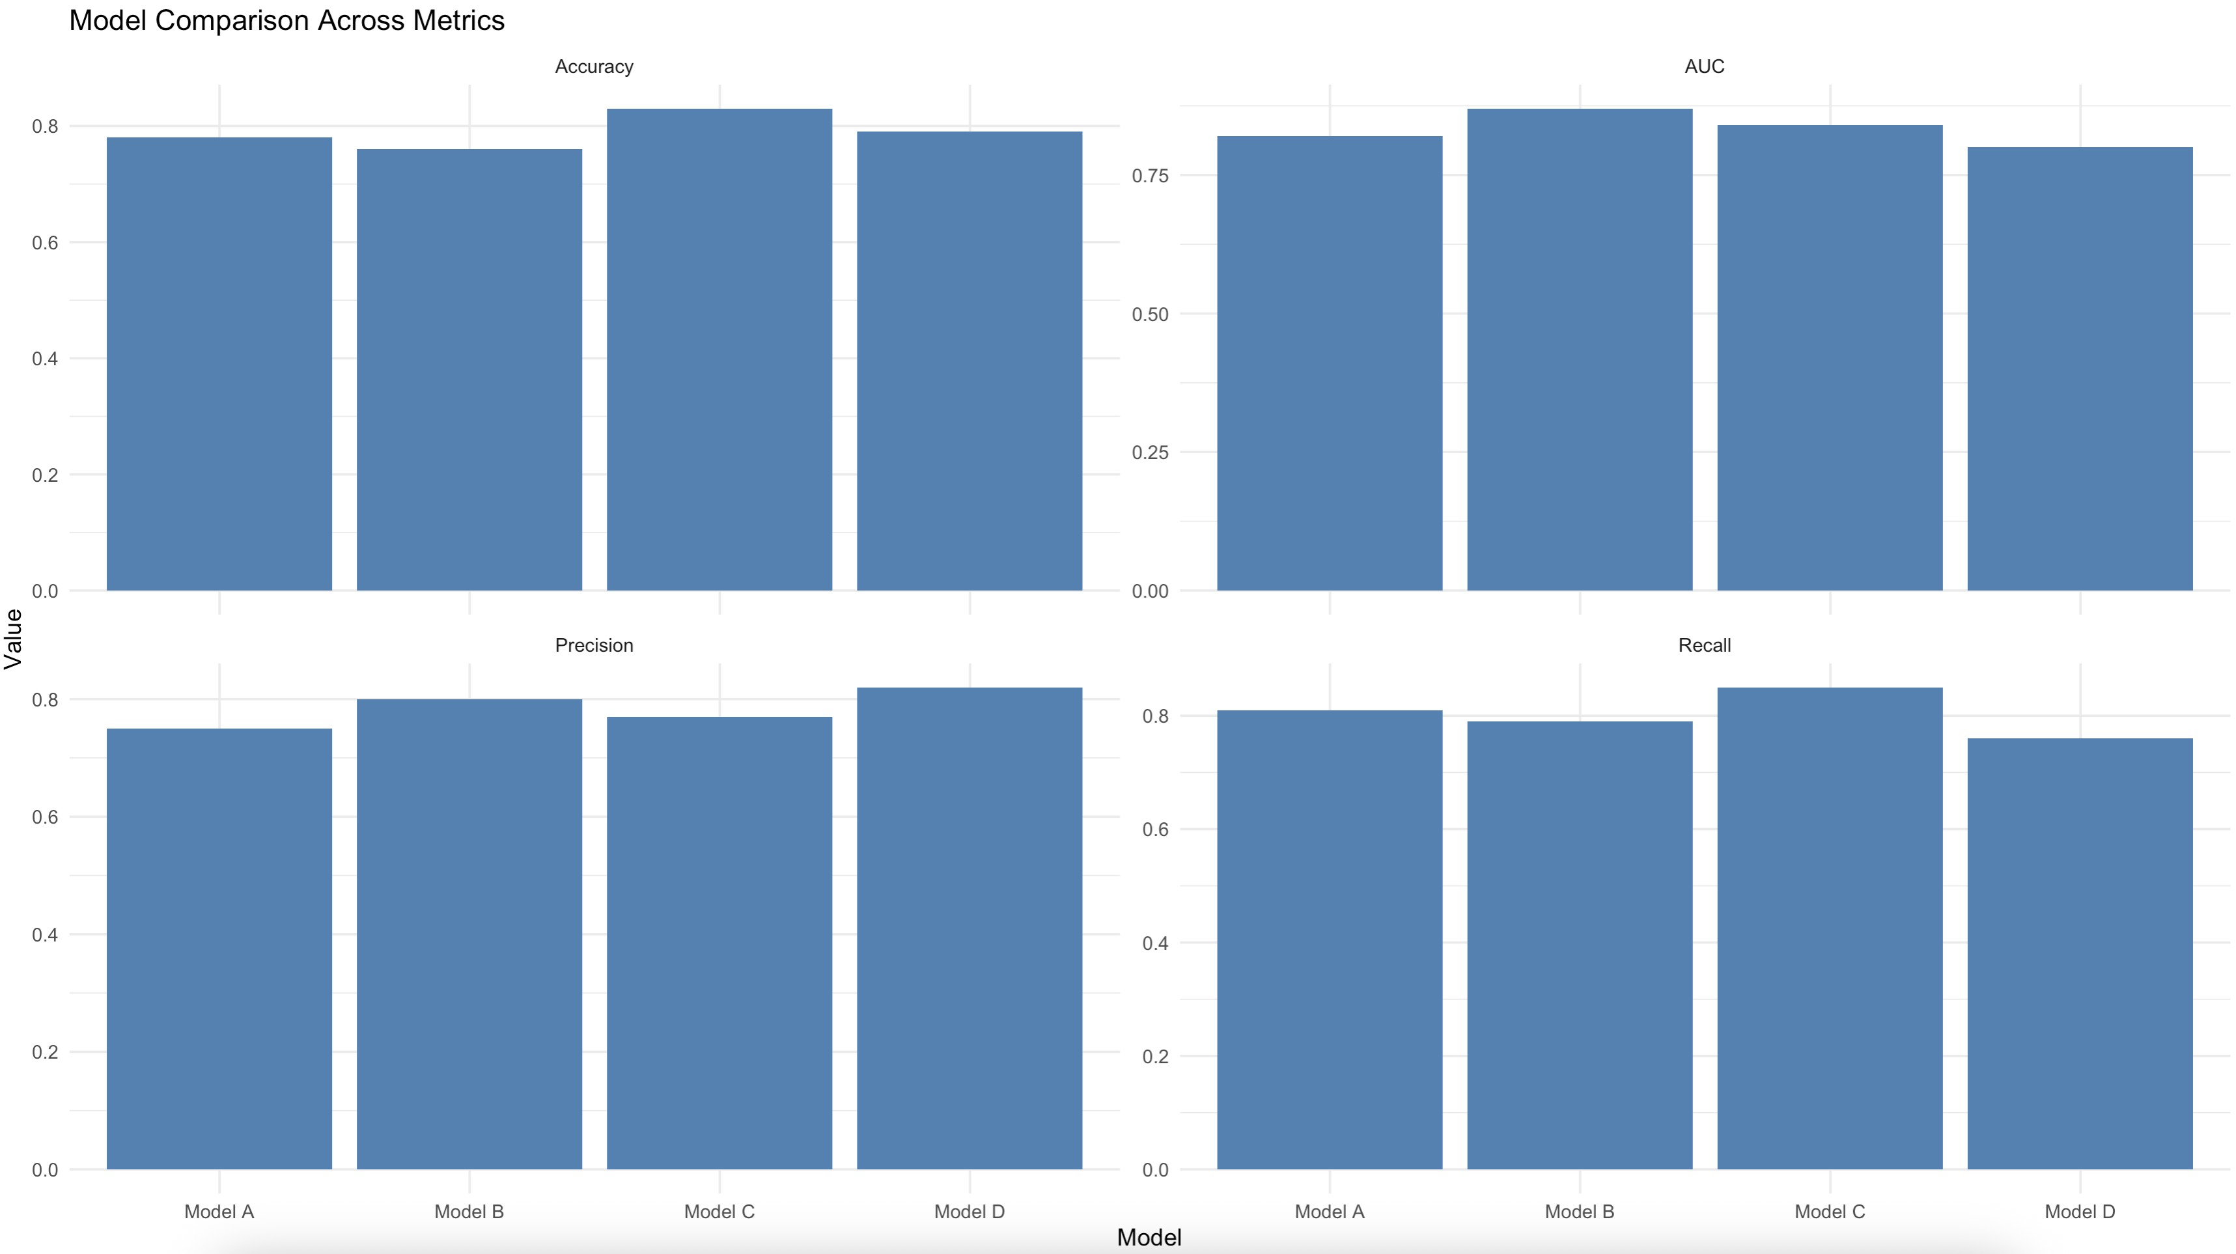

Slide 6
Why Visualization Matters?
It helps us see patterns quickly
It sometimes drives decision making process
Exploratory Data Analysis
Diagnosis check before modeling
It could be misleading ☹

Slide 7
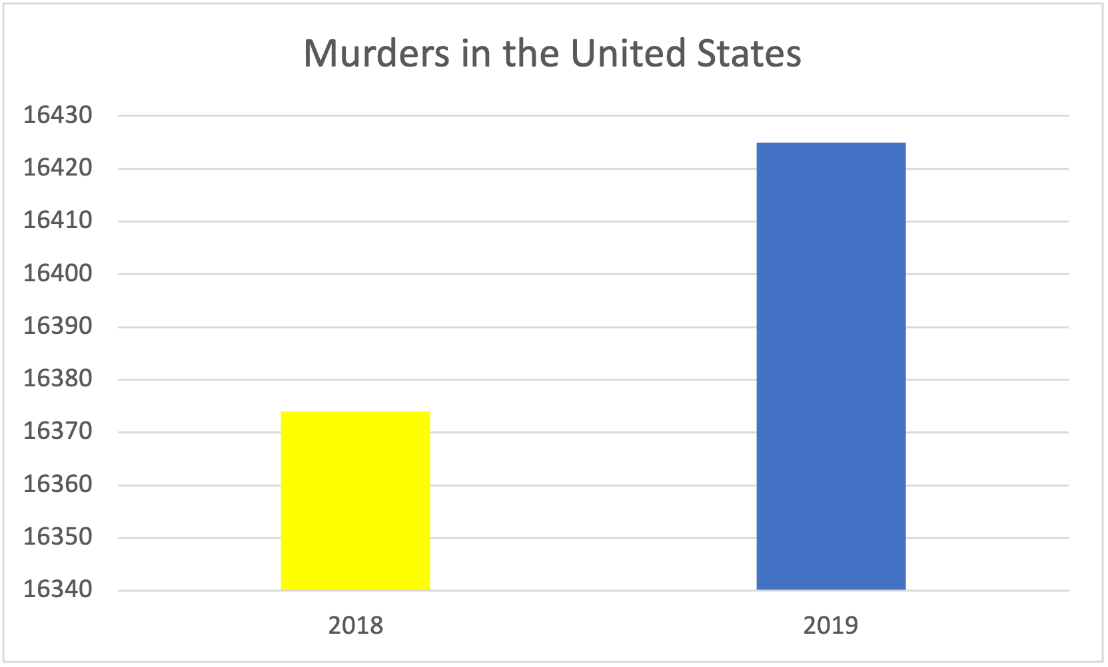
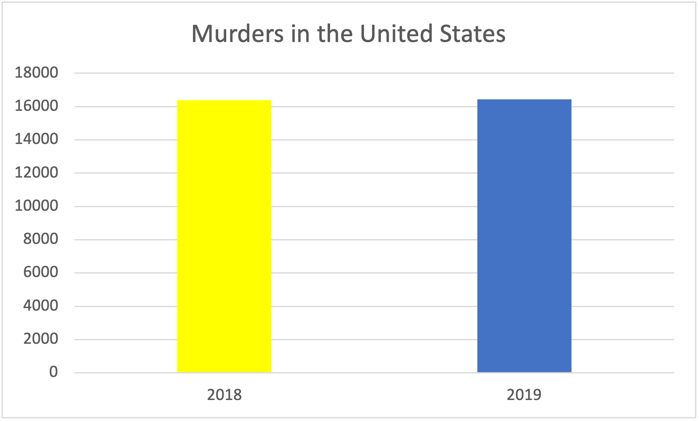
Why Visualization Matters?
It could be misleading ☹
To avoid misleading plots, we have to:
use appropriate axis scales
always include clear title, axis labels, and legend (if applicable)

Slide 8
02
Static Visualization
Exploring library(ggplot2)

Slide 9
Summary of basic functions
ggplot()
Foundation of building a graph in ggplot
gemo_*()
define the geometric objects that can be placed on a graph
Can adjust color, size, and transparency
geom_smooth()
Fit a line that best fits the graph
Can adjust for line types, thickness, color, and confidence band
labs()
Provides customized labels for axes and legends
theme_*()
Choose different themes to finish up the plot
ggplot2 reference website: https://ggplot2.tidyverse.org/reference/index.html

Slide 10
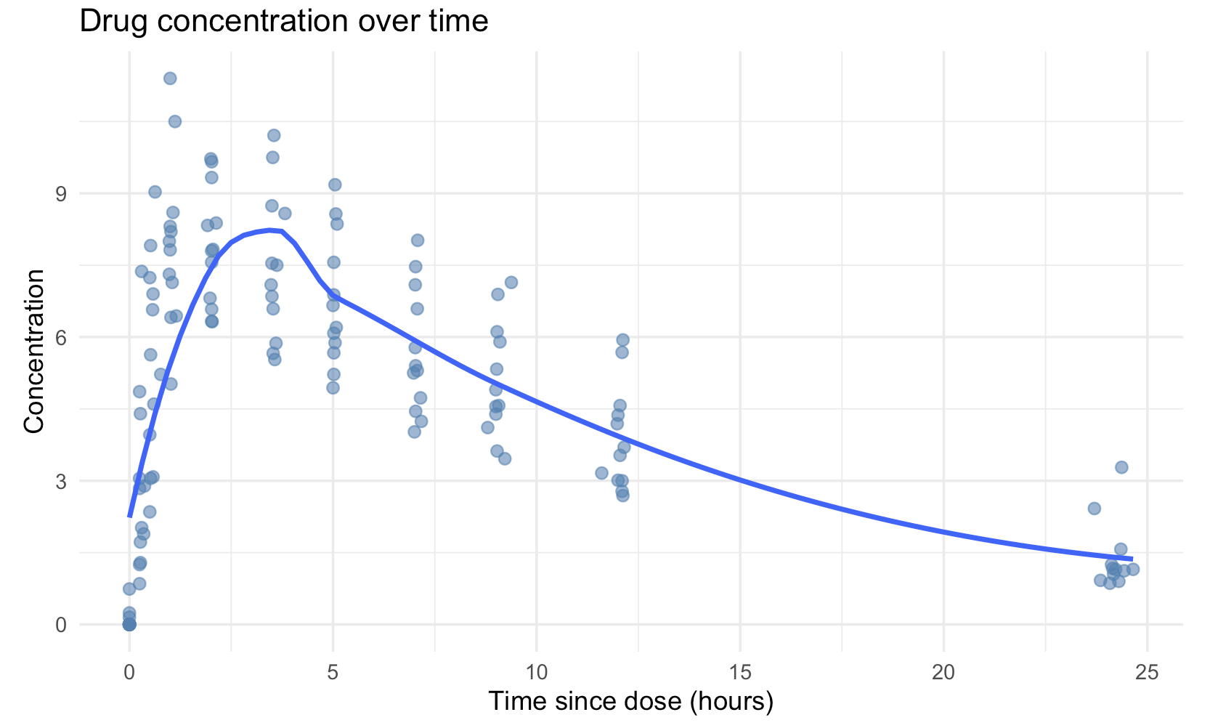
What’s more?
We already had a simple version of the relationship between concentration and time
What if we have a variable that splits data into different groups?
Can we represent those groups with different colors on the current graph?
Yes, we can use grouping

Slide 11
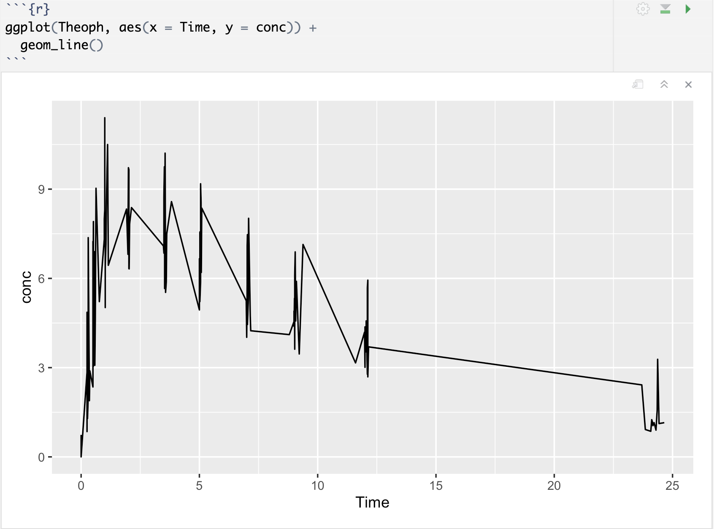
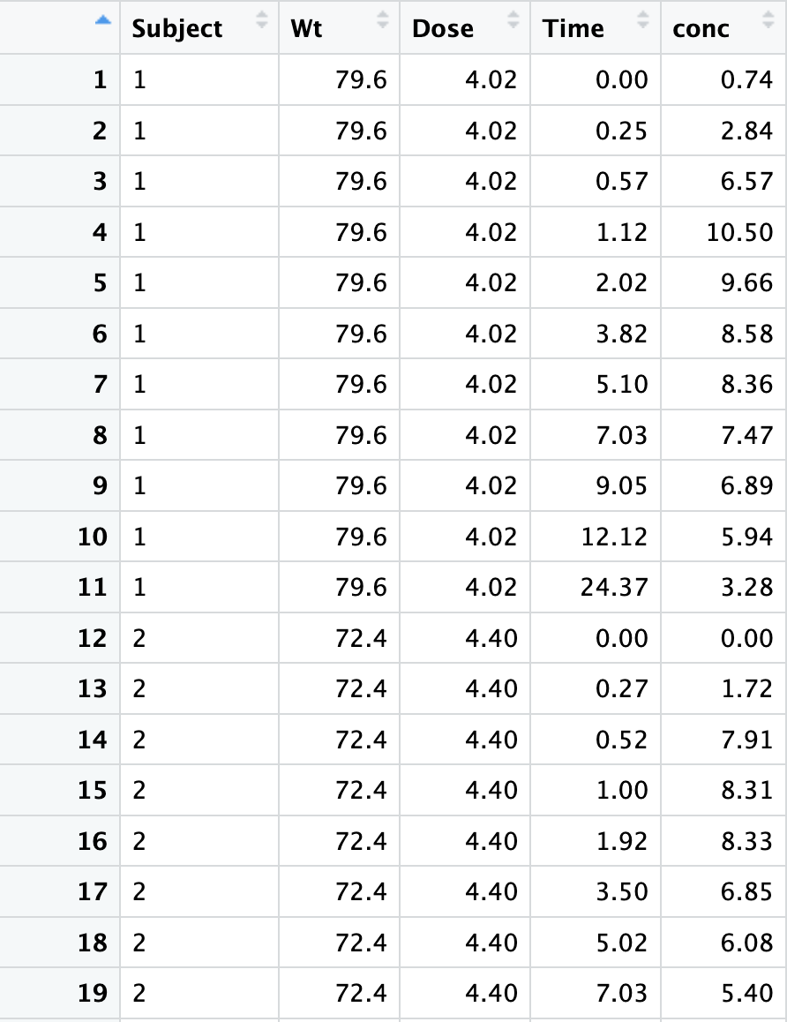
Special Case of “Grouping”
What’s wrong with this plot?
Line jump between different subjects
It connects points that shouldn’t be connected
The path is meaningless and chaotic
What should we do instead?
Special grouping in ggplot
Group by subject/ID

Slide 12
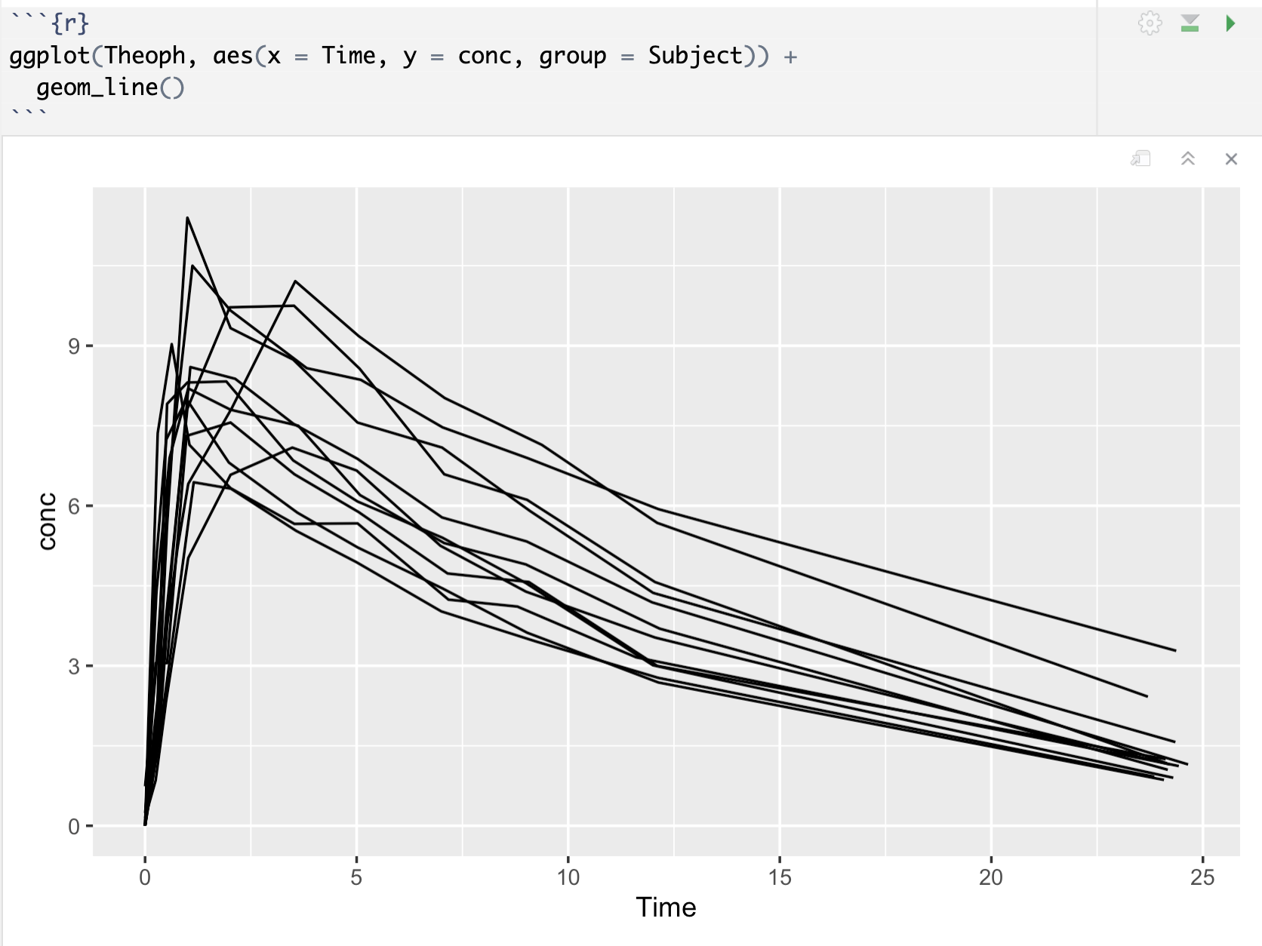
Growth curves (Spaghetti plots)
Each line represents a subject
We have 12 subjects so there are 12 lines
More appropriate to track every subject’s trending

Slide 13
Summary
ggplot()
Foundation of building a graph in ggplot
gemo_*()
define the geometric objects that can be placed on a graph
Can adjust color, size, and transparency
geom_smooth()
Fit a line that best fits the graph
Can adject for line types, thickness, color, and confidence band
labs()
Provides customized labels for axes and legends
Usually finishes with theme_minimal()
theme_*()
Choose different themes to finish up the plot
grouping
define the grouping variable by setting (group = ) in the ggplot() function
facets
facet_wrap
Take one variable
break plots into panels
facet_grid
takes two variables
one as column and one as row
scales
use scale_x_continuous() or scale_y_continuous()
ggplot2 reference website: https://ggplot2.tidyverse.org/reference/index.html

Slide 14
Categorical & Quantitative Data
Univariate Graphs
Categorical
Bar chart
Quantitative
Histogram
Density plot
Bivariate Graphs
Categorical vs. Categorical
Stacked Bar chart
Grouped Bar chart
Segmented Bar Chart
Quantitative vs. Quantitative
Scatter plot
Line plot
Categorical vs. Quantitative
Box plot
Violin plots

Slide 15
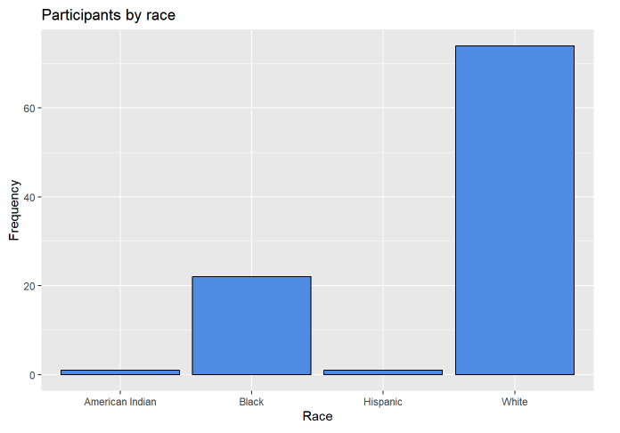
Explore on your own!
Categorical
Plot the distribution of race using bar plot
Use ?geom_bar() to see the options we can tune for the graph
Set the fill as "cornflowerblue"
Set color as "black"
Add labels to the graph to match the final graph shown on the right

Slide 16
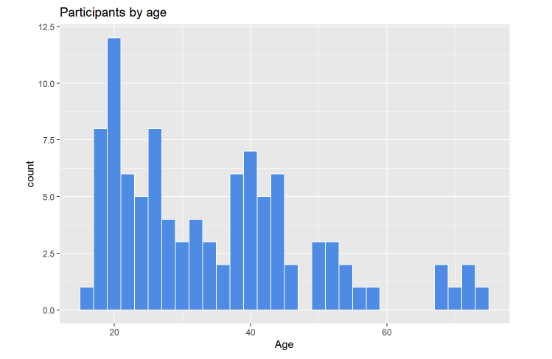
Explore on your own!
Quantitative
Plot the distribution of age using histogram
Use ?geom_bar() to see the options we can tune for the graph
Set the fill as "cornflowerblue"
Set color as ”white”
Add labels to the graph to match the final graph shown on the right

Slide 17
Summary of Static Visualization
Use ggplot() as foundation
change the plot type using geom_*()
Adjust your graphs with different options of colors, edges, and sizes
Always add clear labels and legends
If needed, use facet to make comparison plots

Slide 18
03
Interactive Visualization
Introduction to plotly()

Slide 19
What is plotly()
Plotly is an R package for creating interactive web-based graphs via the open source JavaScript graphing library plotly.js.
By default, Plotly for R runs locally in your web browser or in the R studio viewer.
There are examples of plotly plots here:
https://plotly.com/r/
There is a cheat sheet for plotly plots in the github

Slide 20
Plotly
Using ggplot then convert use ggplotly() to convert them
Work directly with plot_ly() function
Use plot_ly(data, x, y, type) as foundation
Build ggplot first => transform the plot to interactive

Slide 21
Try it yourself!
load the dataset data(mtcars) and do the following
Create a scatterplot of weight vs. mpg
color the points by number of cylinders (cyl)
Add custom hover
Add horsepower (hp) to the hover text

Slide 22
Summary
Interactive plots can allow audience to engage with the visualization more
Use ggplotly() or plot_ly() to create interactive plot
Use layout() to add titles and axes names for plot_ly()
Limitations
Only work on Shiny app (coming up next) or Quarto presentation
Lost the interactive attributes if we download the graph

Slide 23
04
Shiny
How to use Shiny Assistant to help?

Slide 24

What is Shiny?
An R package
A way to create interactive plots, tables, and so forth for clients or other data stakeholders
Think of it like Tableau but with more power (and less user friendly)

Slide 25
Foundations of Shiny
A Shiny app is a web page connected to a computer running a live R session
Three components to a Shiny app:
UI (User Interface): nested R functions that assemble an HTML user interface for your app (controls the layout and appearance)
Server: a function with instructions on how to build and rebuild the R objects displayed in the UI
shinyApp: combines the UI and server into a functioning app

Slide 26
Shiny App Example

Slide 27
How to build Shiny?
We don’t have a lot of time to cover this material
It usually takes a long time to learn the workflow
There’s a ”helper” called Shiny Assistant
We will mainly focus on how to have Shiny Assistant help us design a Shiny app quickly
Shiny Assistant is similar to ChatGPT but only focus on Shiny

Slide 28
Summary
Pros
It gives users maximum freedom to explore visualizations and areas they want to focus on
No need to know HTML/CSS/JavaScript
Everything could be done in R
Cons
Hard to build & potentially a lot of debugging
Need to have data living on cloud instead of local to enable deployment
Can be slow with large datasets

Slide 29
Thank you!

Slide 30
Resources
ggplot2()
https://ggplot2.tidyverse.org/reference/index.html
https://rkabacoff.github.io/datavis/IntroGGPLOT.html
plot_ly()
https://plotly.com/r/getting-started/
Shiny
https://shiny.posit.co/r/getstarted/shiny-basics/lesson1/
https://gallery.shinyapps.io/assistant/
Credit: Dr. Charles South’s lecture on interactive plots and Shiny app

